Slide 1


Investigating the Evolution of Fisher Information for Neural Network Dynamics
%
DPG Frühjahrstagung 2024
Marc Sauter

Slide 2

Previous Talk Fisher Information Fisher Information for Neural Networks Analyzing the Loss Influence Experiment Summary and Outlook People
Collective Variables for Neural Networks
Konstantin Nikolaou

Slide 3
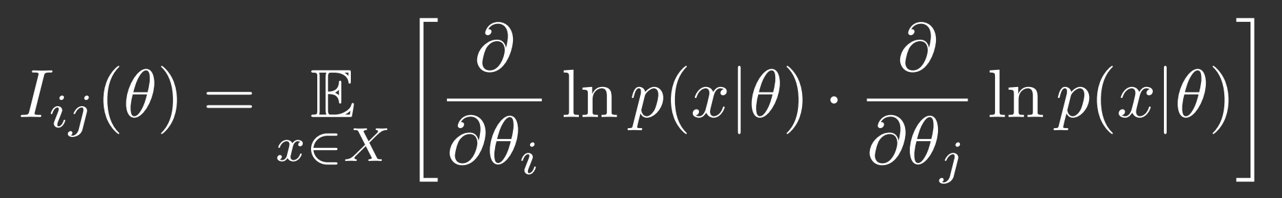
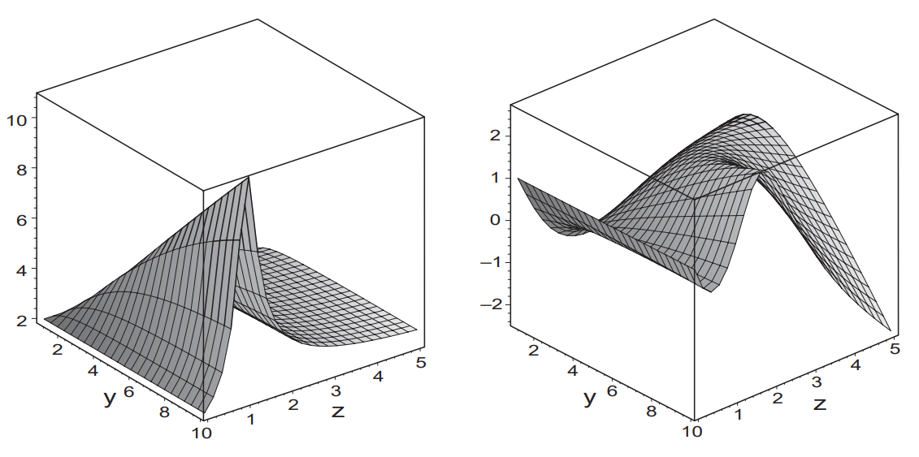
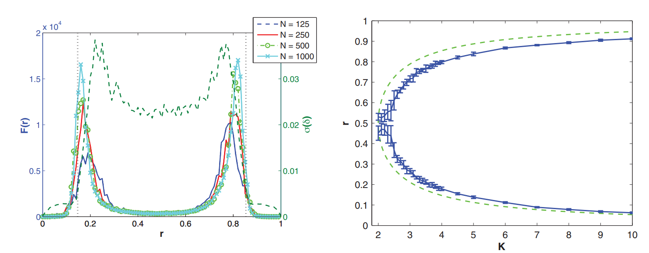
Previous Talk Fisher Information Fisher Information for Neural Networks Analyzing the Loss Influence Experiment Summary and Outlook People
Information Geometry and phase transitions
Janke et al. (2004)
Relating Fisher Information to order parameters
Prokopenko et al. (2011)

Slide 4
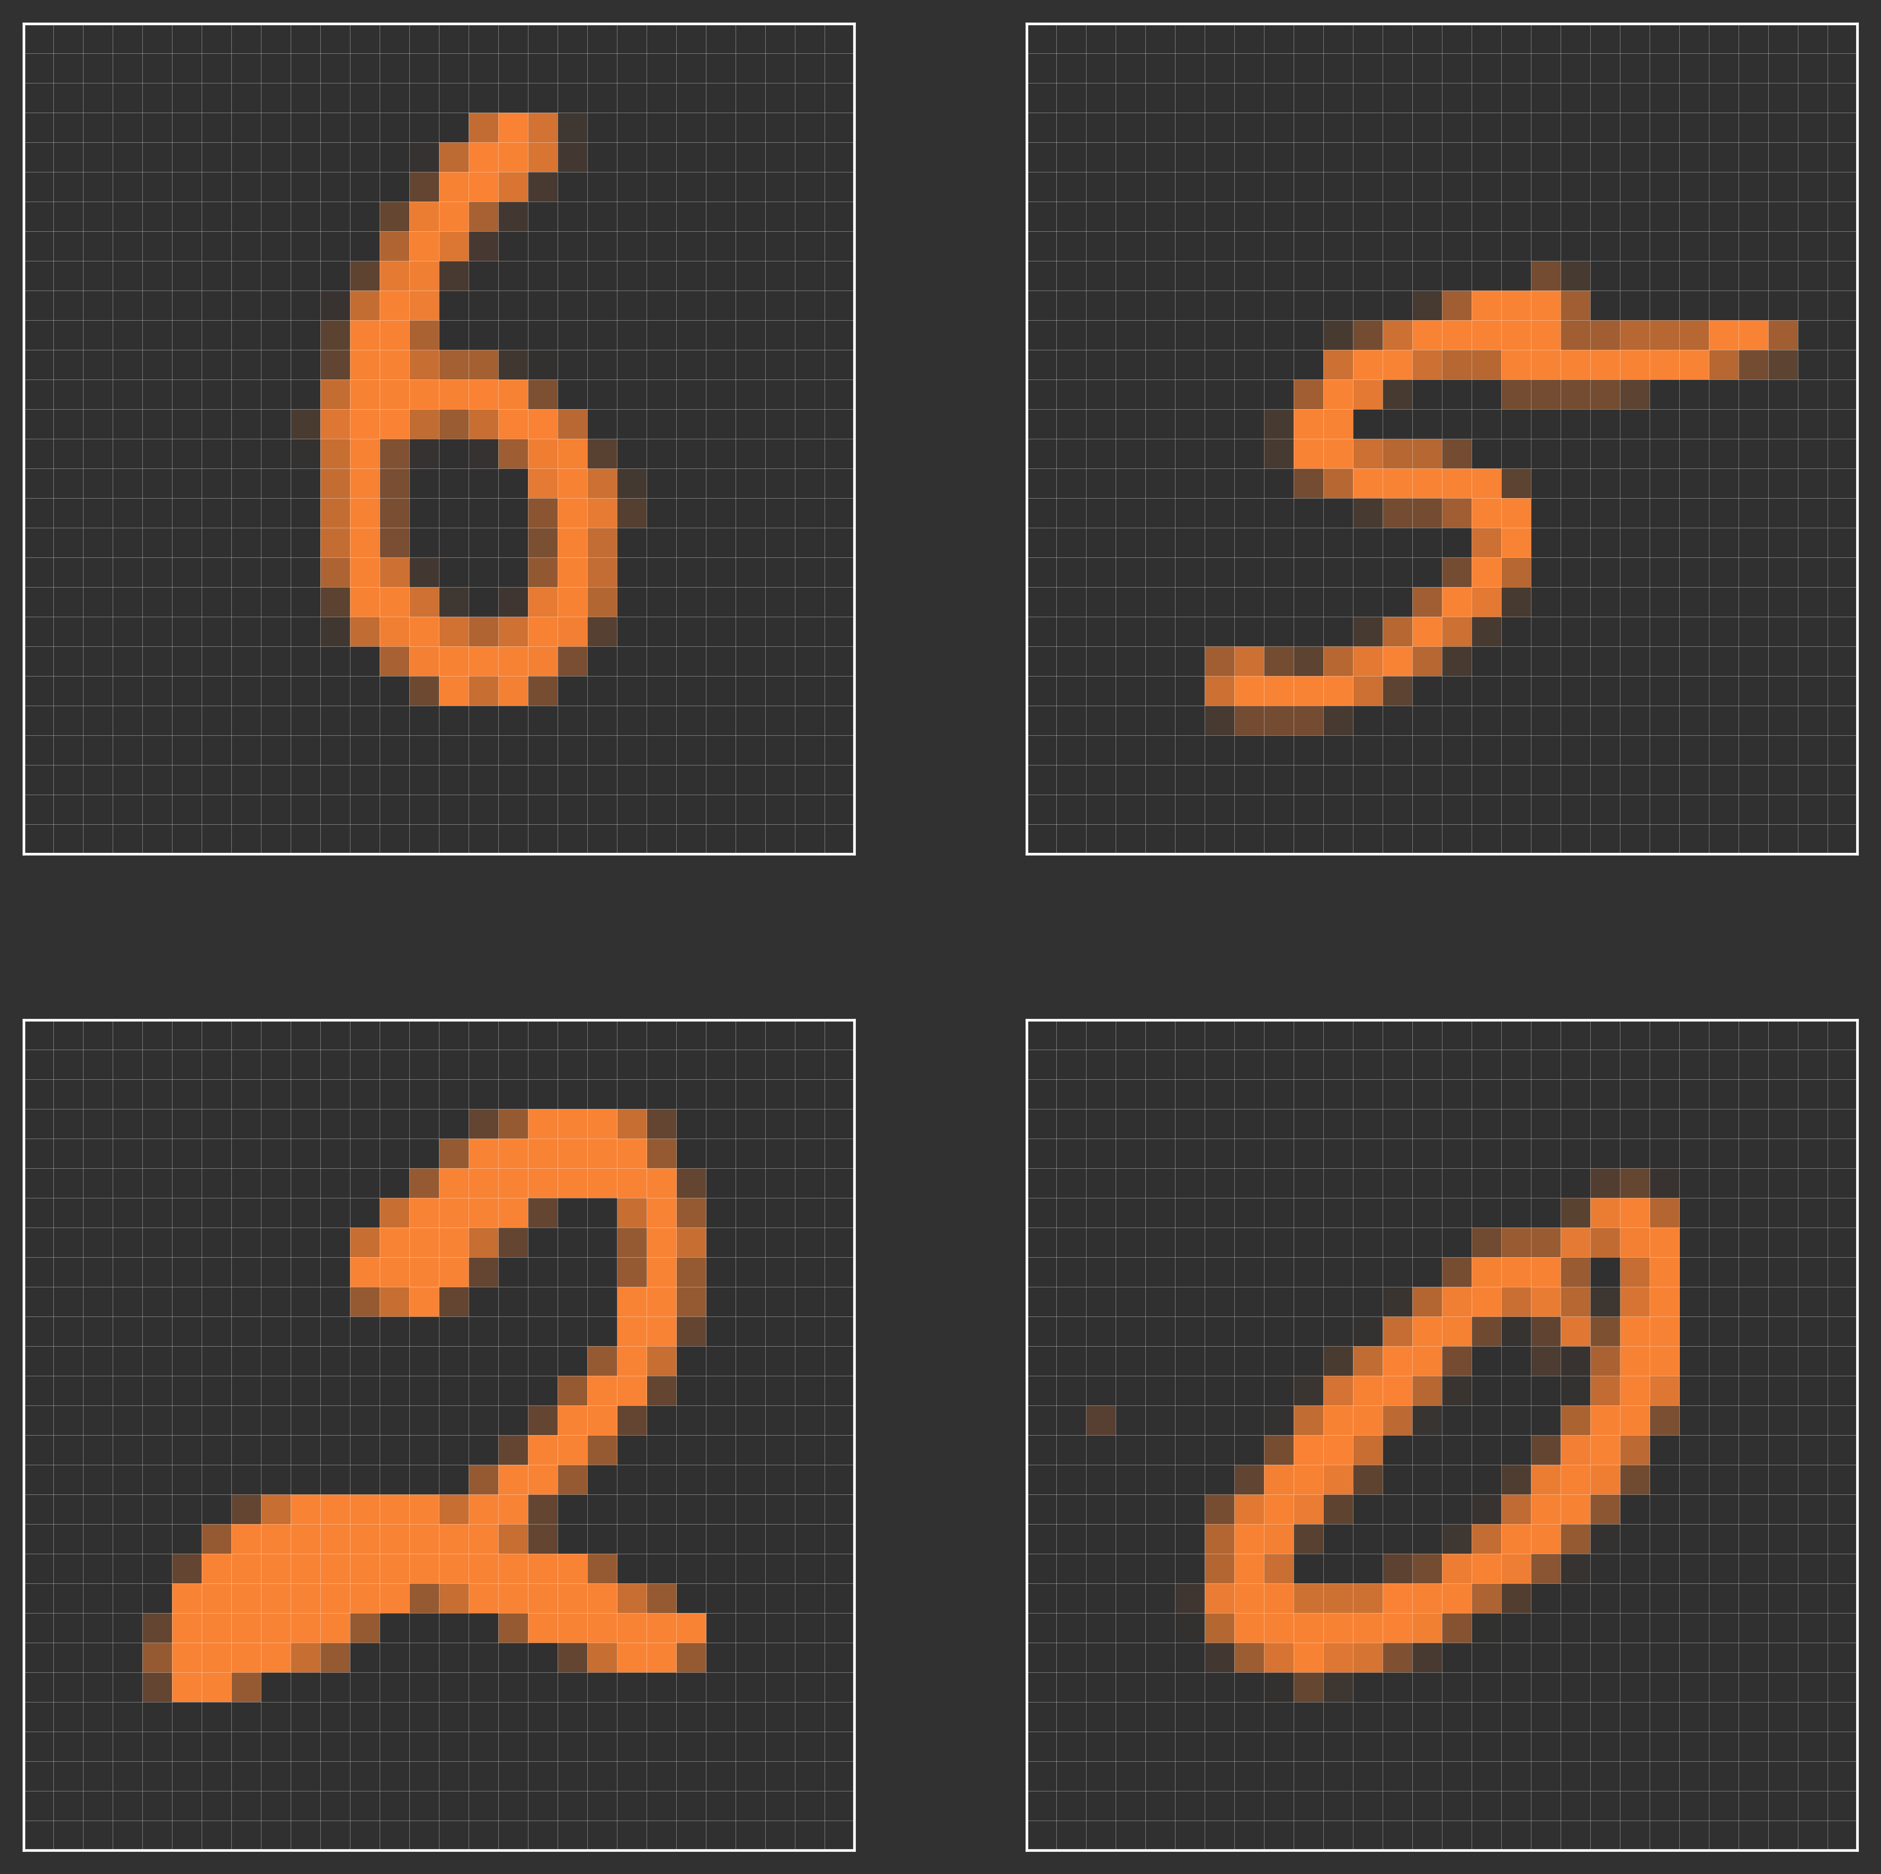
Previous Talk Fisher Information Fisher Information for Neural Networks Analyzing the Loss Influence Experiment Summary and Outlook People
Dataset

Slide 5
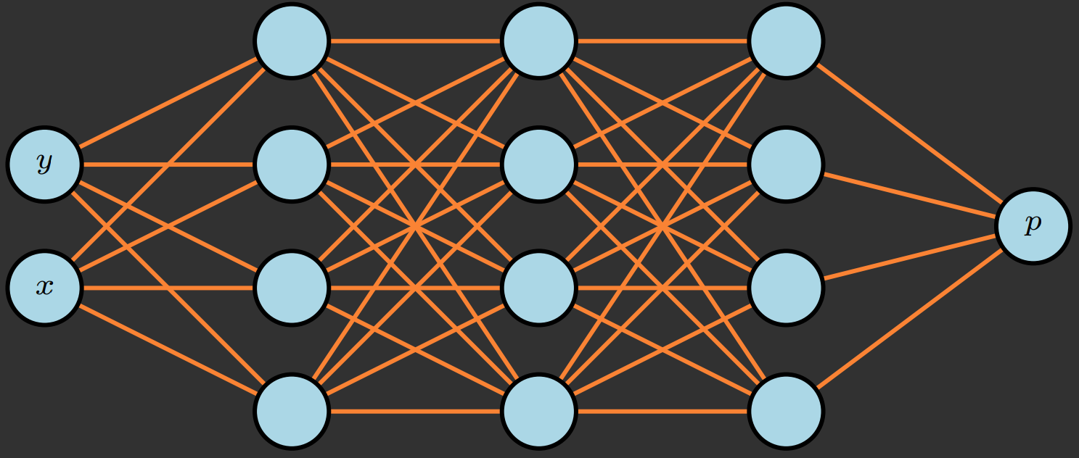
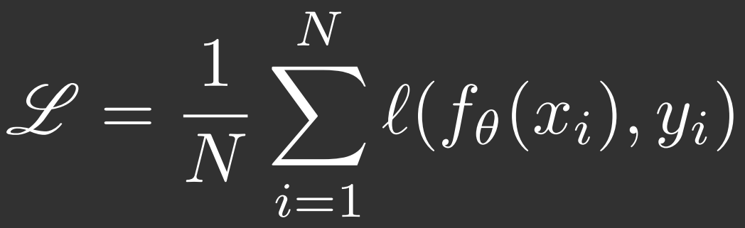
Previous Talk Fisher Information Fisher Information for Neural Networks Analyzing the Loss Influence Experiment Summary and Outlook People
Dataset
Network
Introduce Loss function

Slide 6
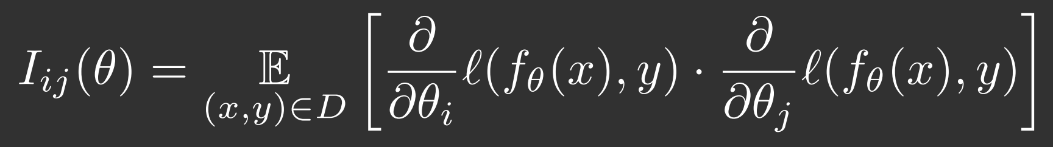
Previous Talk Fisher Information Fisher Information for Neural Networks Analyzing the Loss Influence Experiment Summary and Outlook People

Slide 7
Previous Talk Fisher Information Fisher Information for Neural Networks Analyzing the Loss Influence Experiment Summary and Outlook People
Established concept
Has been utilized in Natural Gradient Descent algorithm

Slide 8
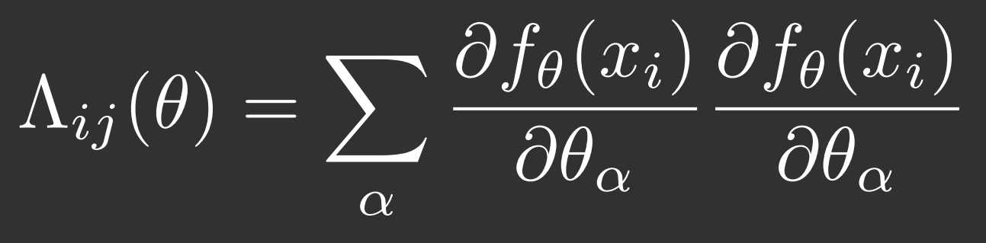
Previous Talk Fisher Information Fisher Information for Neural Networks Analyzing the Loss Influence Experiment Summary and Outlook People
Related Network dependent matrix
Full Fisher Information

Slide 9

Previous Talk Fisher Information Fisher Information for Neural Networks Analyzing the Loss Influence Experiment Summary and Outlook People
Related Network dependent matrix
Full Fisher Information

Slide 10
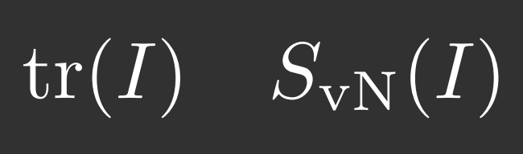
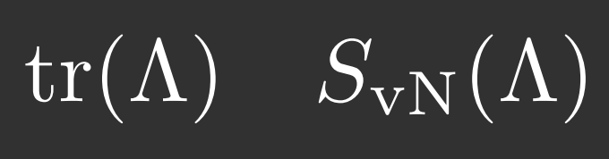
Previous Talk Fisher Information Fisher Information for Neural Networks Analyzing the Loss Influence Experiment Summary and Outlook People
Related Network dependent matrix
Full Fisher Information

Slide 11
Previous Talk Fisher Information Fisher Information for Neural Networks Analyzing the Loss Influence Experiment Summary and Outlook People

Slide 12
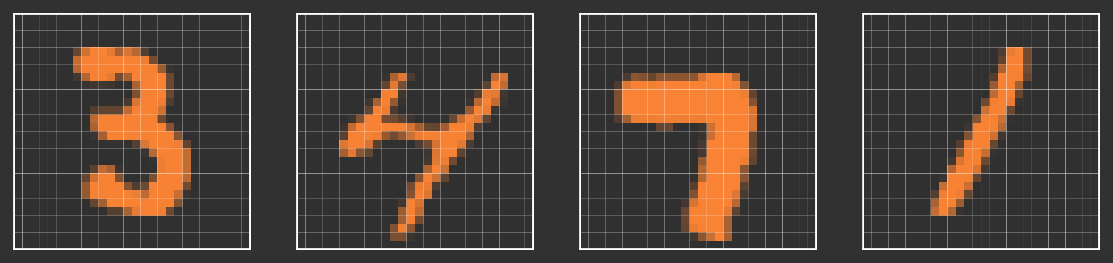
Previous Talk Fisher Information Fisher Information for Neural Networks Analyzing the Loss Influence Experiment Summary and Outlook People

Slide 13
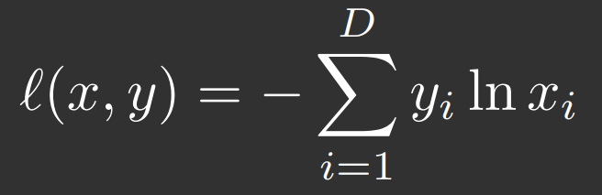
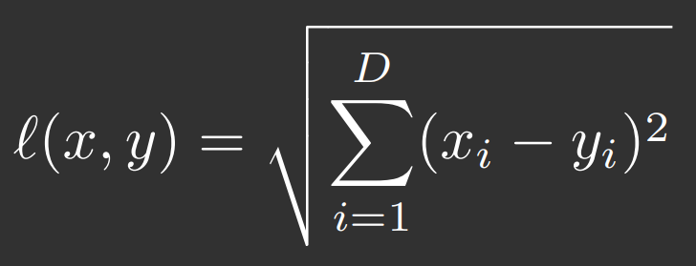
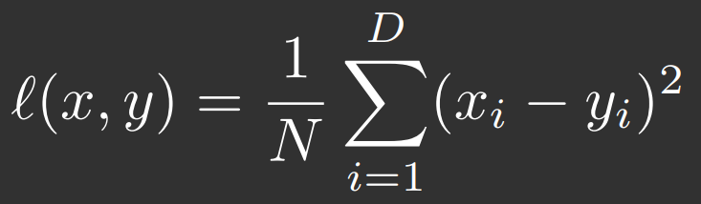
Previous Talk Fisher Information Fisher Information for Neural Networks Analyzing the Loss Influence Experiment Summary and Outlook People
Cross Entropy | Lp norm of order 2 | Mean Squared Error

Slide 14
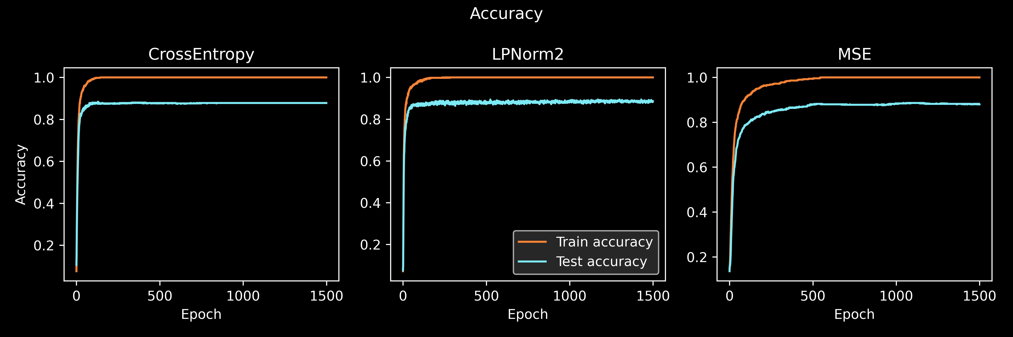
Previous Talk Fisher Information Fisher Information for Neural Networks Analyzing the Loss Influence Experiment Summary and Outlook People

Slide 15
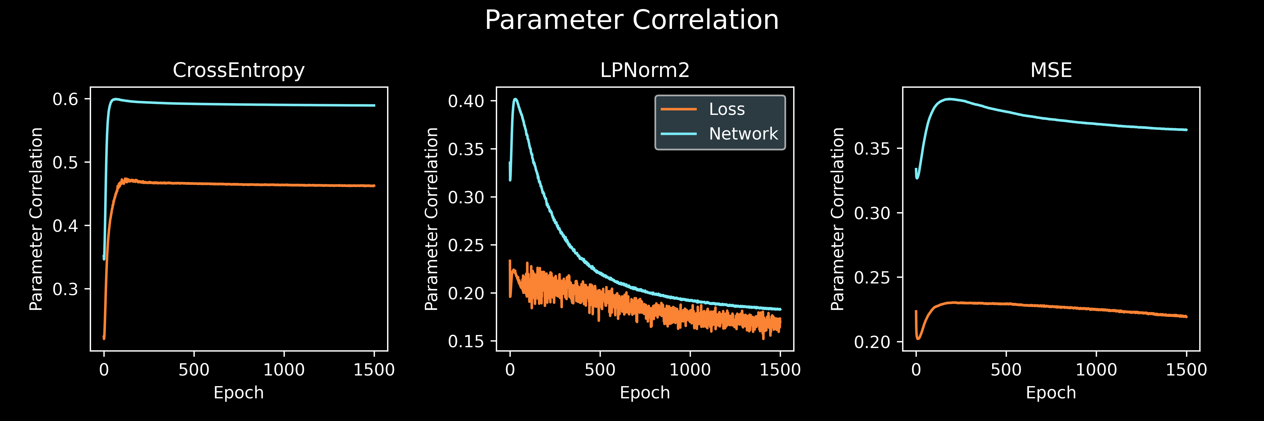
Previous Talk Fisher Information Fisher Information for Neural Networks Analyzing the Loss Influence Experiment Summary and Outlook People

Slide 16
Previous Talk Fisher Information Fisher Information for Neural Networks Analyzing the Loss Influence Experiment Summary and Outlook People

Slide 17
Previous Talk Fisher Information Fisher Information for Neural Networks Analyzing the Loss Influence Experiment Summary and Outlook People

Slide 18
Previous Talk Fisher Information Fisher Information for Neural Networks Analyzing the Loss Influence Experiment Summary and Outlook People

Slide 19
Previous Talk Fisher Information Fisher Information for Neural Networks Analyzing the Loss Influence Experiment Summary and Outlook People

Slide 20
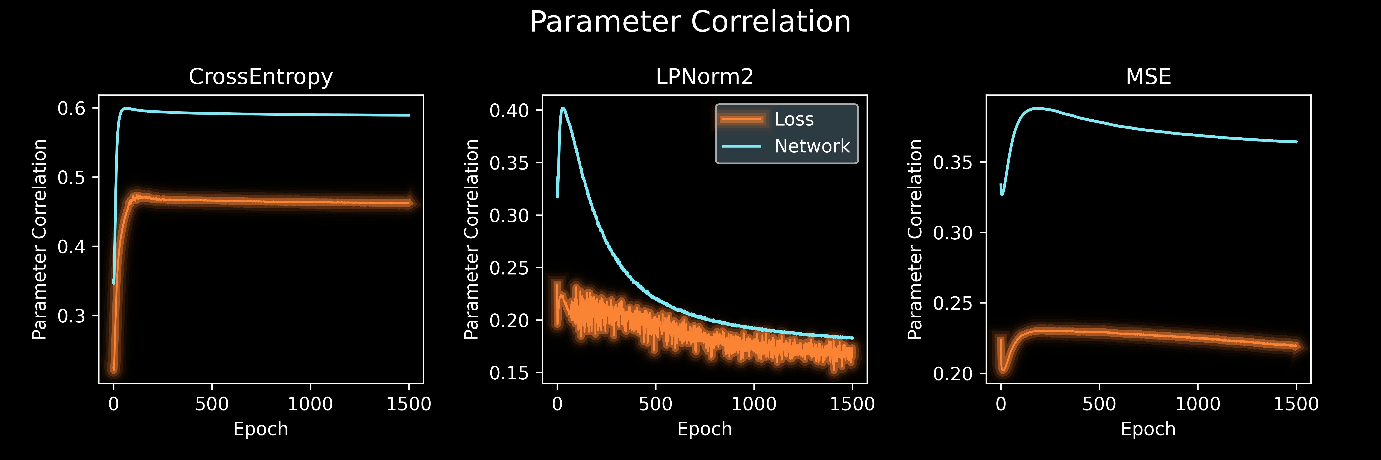
Previous Talk Fisher Information Fisher Information for Neural Networks Analyzing the Loss Influence Experiment Summary and Outlook People

Slide 21
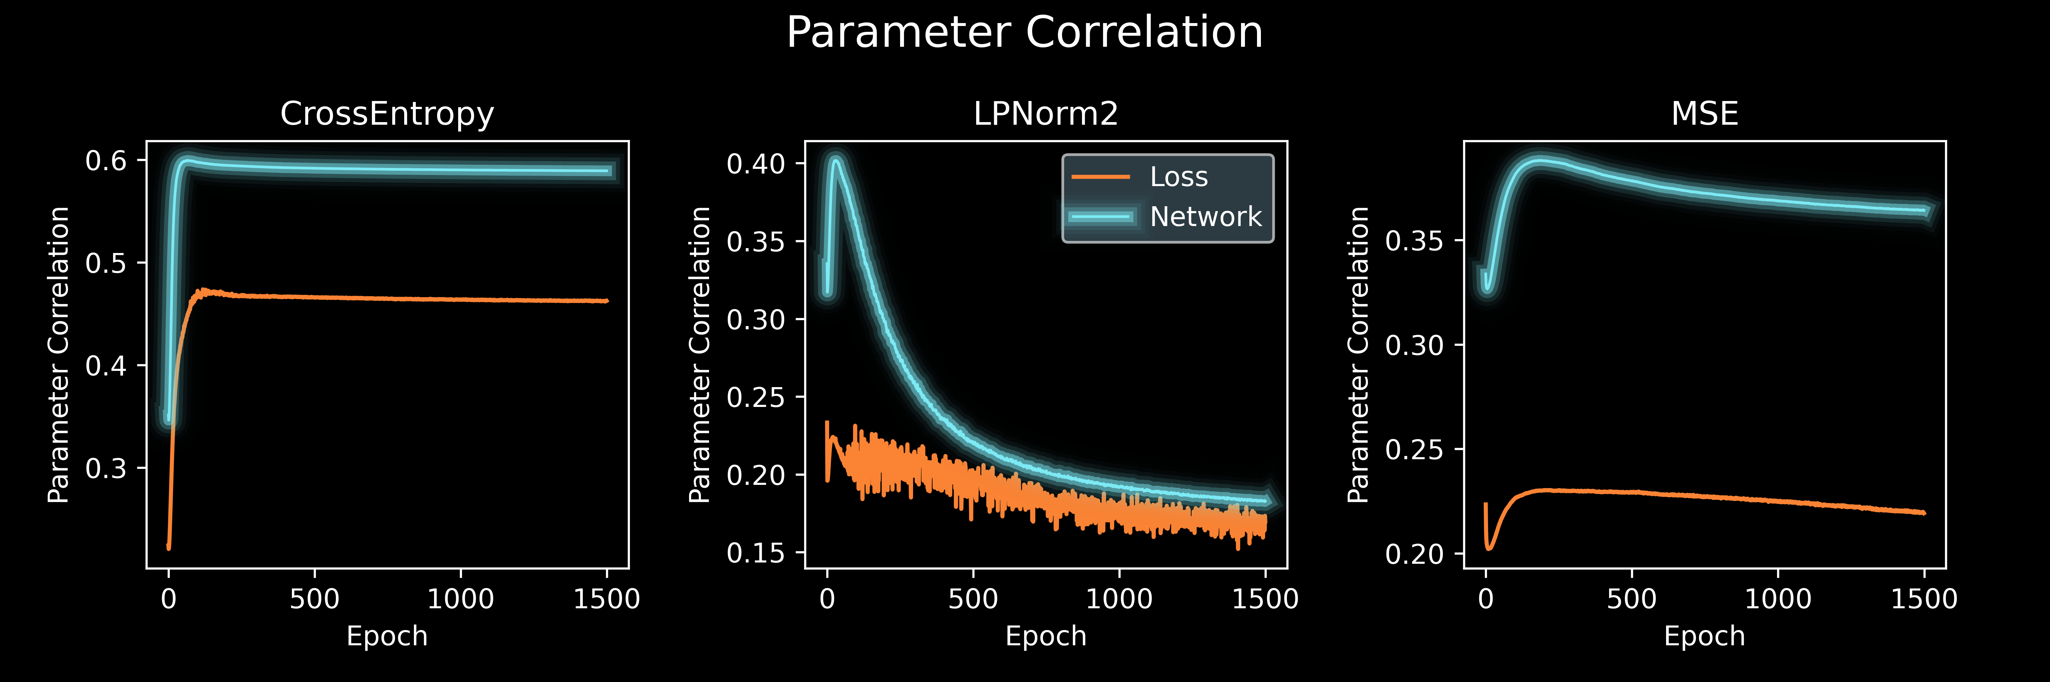
Previous Talk Fisher Information Fisher Information for Neural Networks Analyzing the Loss Influence Experiment Summary and Outlook People

Slide 22
Previous Talk Fisher Information Fisher Information for Neural Networks Analyzing the Loss Influence Experiment Summary and Outlook People

Slide 23
Previous Talk Fisher Information Fisher Information for Neural Networks Analyzing the Loss Influence Experiment Summary and Outlook People
→ Loss function choice has a major impact on Parameter Correlation Dynamics

Slide 24
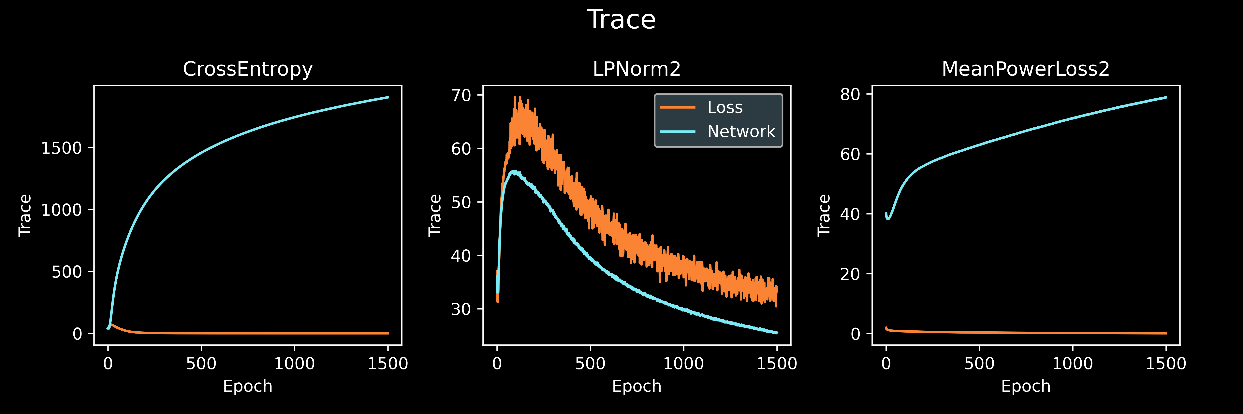
Previous Talk Fisher Information Fisher Information for Neural Networks Analyzing the Loss Influence Experiment Summary and Outlook People

Slide 25
Previous Talk Fisher Information Fisher Information for Neural Networks Analyzing the Loss Influence Experiment Summary and Outlook People
→ Loss function choice impacts the sensitivity of the network after training

Slide 26
Previous Talk Fisher Information Fisher Information for Neural Networks Analyzing the Loss Influence Experiment Summary and Outlook People
Loss function choice impacts the sensitivity of the network after training
Useful for adversarial attack protection

Slide 27
Previous Talk Fisher Information Fisher Information for Neural Networks Analyzing the Loss Influence Experiment Summary and Outlook People
Fisher Information is valuable for collective variables due to potential splitting of loss and network contributions
Observing traces and entropies yields information about the sensitivities and parameter correlations of loss and network output
For example useful for adversarial attack protection

Slide 28



Previous Talk Fisher Information Fisher Information for Neural Networks Analyzing the Loss Influence Experiment Summary and Outlook People
Konstantin Nikolaou
(ICP Stuttgart)
Samuel Tovey
(ICP Stuttgart)
Sven Krippendorf
(LMU Munich)
Christian Holm
(Director of ICP Stuttgart)

